Slide 1

VAAGDEVI COLLEGE OF ENGINEERING

Slide 2

TITLE
DIGITAL CURRENCY PRICE PREDICTION
TEAM-4
Under the guidance of
Mrs.G.Pallavi

Slide 3
TEAM MEMBERS
► DANYAM SANTHOSHINI RUPA (20641A6720)
► BANOTHU SHIREESHA (20641A6715)
► GAJJALA KALYAN (20641A6728)
► DAMERA ANANYA (20641A6719)

Slide 4
Introduction
You must have heard or invested in any digitalcurrency once in your
life. It is a digital medium of exchange that is encrypted and decentralized. Many people use digitalcurrencies as a form of investing because it gives great returns even in a short period. BITCOIN, ETHEREUM, and DOGE Coin are among the popular digitalcurrencies today. If you want to know how to predict the future prices of any digitalcurrency with machine learning, this helps for you. In this Project, I will walk you through the task of digitalcurrency price prediction with machine learning using Python.

Slide 5
Abstract
In project we have Stated correctly forecast the Bitcoin price while taking into account a number of factors that influence the Bitcoin value. our goal is to comprehend and identify everyday trends in the Bitcoin market. We analyze daily data for 3 digital currencies for the period between Sep 2014 and Aug 2023. To forecast the closing price of the following day, factors including the opening price, highest price, lowest price,volume. we have collected the latest Bitcoin prices data from Yahoo Finance, using the yfinance API to predict the bitcoin prices for next 365 days. We used the ARIMA (AutoRegressive Integrated Moving Average) model. It is a popular and powerful time series forecasting technique for predicting the Digital Currency prices.

Slide 6
Existing System
In existing system we analyzed stock markets prediction, suggests that these methods could be effective also in predicting digital currencies prices. However, the application of machine learning algorithms to the digital currency market has been limited so far to the analysis of Bitcoin prices, using linear regression algorithm. These studies were able to anticipate, to different degrees, the price fluctuations of Bitcoin, and revealed that best results. The system currently in use has a prediction of one month.

Slide 7
Proposed System
Here, we test the performance of model in predicting daily digital currency prices for 3currencies. Use the fitted ARIMA model to forecast future values based on the patterns observed in historical data. In all cases, we build investment portfolios based on the predictions and we compare their performance in terms of return on investment. We find that this model perform better than a baseline ‘simple moving average model where a currency’s price is predicted as the average price across the preceding days. our current analysis extends these forecasts for a one-year period.

Slide 8
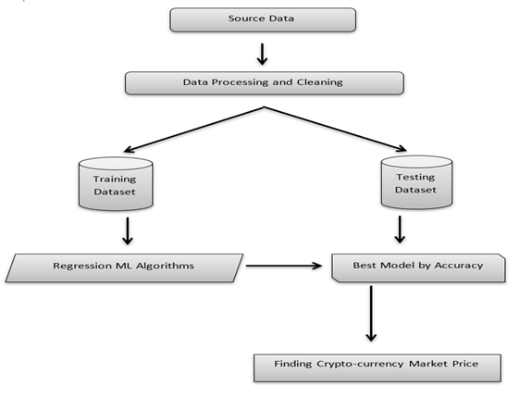
Flow Chart

Slide 9
code
pip install yfinance
import pandas as pd
import yfinance as yf
import datetime
from datetime import date, timedelta
today = date.today()
d1 = today.strftime("%Y-%m-%d")
end_date = d1
d2 = date.today() - timedelta(days=6000)
d2 = d2.strftime("%Y-%m-%d")
start_date = d2
data = yf.download('BTC-USD',
start=start_date,
end=end_date,
progress=False)
data["Date"] = data.index
data = data[["Date", "Open", "High", "Low", "Close", "Adj Close", "Volume"]]
data.reset_index(drop=True, inplace=True)
print(data.head(6000))

Slide 10
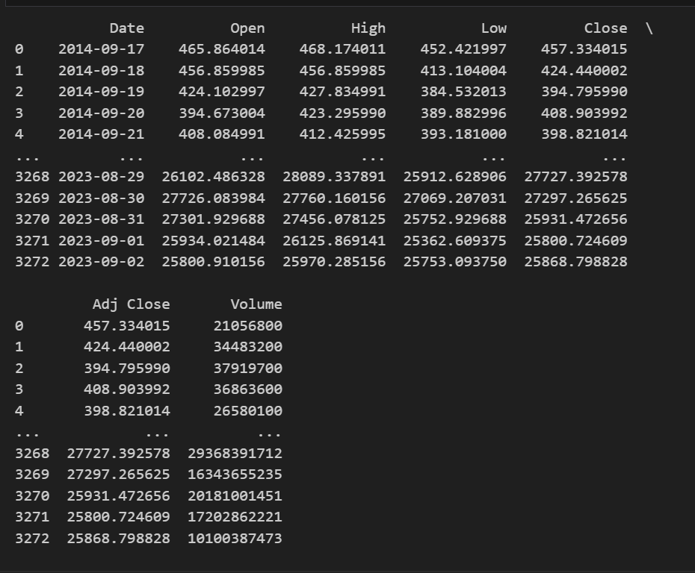
HISTORICAL DATA

Slide 11
import plotly.graph_objects as go
figure = go.Figure(data=[go.Candlestick(x=data["Date"],
open=data["Open"],
high=data["High"],
low=data["Low"],
close=data["Close"])])
figure.update_layout(title = "Bitcoin Price Analysis",
xaxis_rangeslider_visible=False)
figure.show()

Slide 12
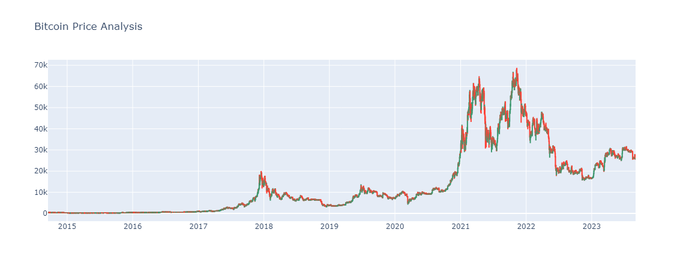

Slide 13
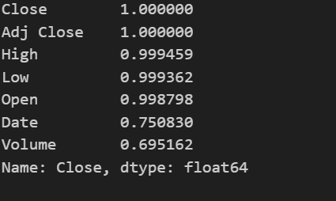
correlation = data.corr()
print(correlation["Close"].sort_values(ascending=False))

Slide 14
pip install AutoTS
from autots import AutoTS
model = AutoTS(forecast_length=365, frequency='infer', ensemble='simple')
model = model.fit(data, date_col='Date', value_col='Close', id_col=None)
prediction = model.predict()
forecast = prediction.forecast
print(forecast)

Slide 15
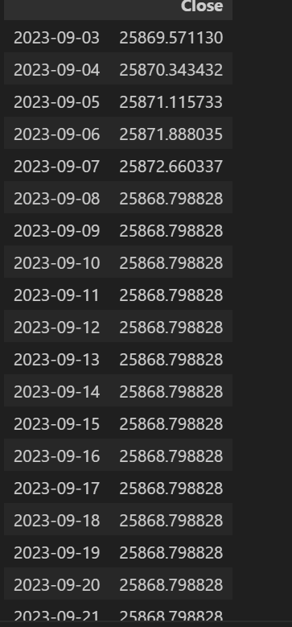
Output

Slide 16
Login page
<!DOCTYPE html>
<html lang="en" dir="ltr">
<head>
<meta charset="utf-8">
<title>Digital currency prediction</title>
<link rel="stylesheet" href="css/style1.css">
<link href="img/future-cryptocurrency.webp" rel="icon">
<meta name="viewport" content="width=device-width, initial-scale=1.0">
</head>
<body>
<div class="wrapper" style="margin-right: 850px;">
<div class="title-text">

Slide 17
<div class="title login">Login Form</div>
<div class="title signup">Signup Form</div>
</div>
<div class="form-container">
<div class="slide-controls">
<input type="radio" name="slide" id="login" checked>
<input type="radio" name="slide" id="signup">
<label for="login" class="slide login">Login</label>
<label for="signup" class="slide signup">Signup</label>
<div class="slider-tab"></div>
</div>
<div class="form-inner">
<form action="stu.html" class="login">
<div class="field">
<input type="text" placeholder="Email Address" required>
</div>

Slide 18
<div class="field">
<input type="password" placeholder="Password" required>
</div>
<div class="pass-link"><a href="#">Forgot password?</a></div>
<div class="field btn">
<div class="btn-layer"></div>
<!-- <a style="color: white; text-align: cen-ter;" href="index.html">Login</a> -->
<input type="submit" value="Login">
</div>
<div class="signup-link">Not a member? <a href="">Signup</a></div>

Slide 19
</form>
<form action="login.html" class="signup">
<div class="field">
<input type="text" placeholder="Email Address" required>
</div>
<div class="field">
<input type="password" placeholder="Password" required>
</div>
<div class="field">
<input type="password" placeholder="Confirm password" required>
</div>
<div class="field btn">
<div class="btn-layer"></div>

Slide 20
<input type="submit" value="Signup">
</div>
</form>
</div>
</div>
</div>
<script>
const loginText = document.querySelector(".title-text .login");
const loginForm = document.querySelector("form.login");
const loginBtn = document.querySelector("label.login");
const signupBtn = document.querySelector("label.signup");
const signupLink = document.querySelector("form .signup-link a");

Slide 21
signupBtn.onclick = (()=>{
loginForm.style.marginLeft = "-50%";
loginText.style.marginLeft = "-50%";
});
loginBtn.onclick = (()=>{
loginForm.style.marginLeft = "0%";
loginText.style.marginLeft = "0%";
});
signupLink.onclick = (()=>{
signupBtn.click();
return false;
});
</script>
</body>
</html>

Slide 22


Slide 23
Modules
AutoTs: is like a super-smart tool that helps in predicting future trends automatically. It's capable of choosing the best method for forecasting without needing you to manually pick one. It's like having a smart assistant for forecasting that figures out the best way to predict future values based on the data.
Pandas: is like a Swiss Army knife for handling data. It helps in organizing and cleaning up the information needed for forecasting. It's great for arranging the data neatly, so the forecasting tool (autots) can understand and work with it effectively.
yfinance api: that allows users to access financial data from Yahoo Finance programmatically. It provides a convenient way to retrieve historical market data, real-time quotes, and other financial information for various financial instruments, including stocks, cryptocurrencies, and more.

Slide 24
Algorithms used
□ Linear Regression
□ Data Preprocessing Algorithms
□ Graphical Visualization Techniques
□ Machine Learning Integration Algorithms

Slide 25
Requirements
Hardware Requirements
Software Requirements
♦ RAM(16GB)
♦ ROM(64 bit processor)
♦ HARD DISK 324GB
♦ Python
♦ Anaconda
♦ Windows 11
♦ Vs code

Slide 26
Pros
Cons
● Data-driven decision making
● Risk Mitigation
● high security
● financial planning
● peer-to-peer network
● Decentralization
● Transparency
● Volatility
● uncertainty and risk

Slide 27
Conclusion
This project aimed to provide analysis of digitalcurrency use in general. Our empirical research found that the future of digitalcurrencies could be bright. The use of digital currency use in facilitating trade, cost reduction.Buying and selling result in a change in the price of any digitalcurrency, but buying and selling trends depend on many factors. Using machine learning for digitalcurrency price prediction can only work in situations where prices change due to historical prices that people see before buying and selling their digitalcurrency

Slide 28


